Slide 1
Lecture 4
UE4 Gameplay Framework Classes

Slide 2
Lecture Goals and Outcomes
The goals of this lecture are to
Identify the Gameplay Framework classes
Present the Game Mode class and its default classes
Explain the Player Controller and Player State classes
Present the Pawn class and some subclasses
Introduce the Game Instance and Game Session classes
By the end of this lecture you will be able to
Identify the common classes of the Gameplay Framework
Understand the relationship between the Game Mode and Game State
Understand the relationship between the Player Controller and Player State
Know how to possess a Pawn using a Controller
Draw simple information using the HUD class

Slide 3
Common Classes
Object
Actor
Pawn
Game Mode
Controller
Player Controller
AI Controller
Character
Actor Component
Scene Component
When creating a Blueprint, you will be presented with a list of classes commonly used as the Blueprint parent class. These common classes are part of the Gameplay Framework and are used to represent players, characters, controllers, and game rules.
The image on the right shows the hierarchy of the common classes. The arrow indicates that the class on the right is inheriting from the class on the left. There is a base class in Unreal called the Object class.

Slide 4
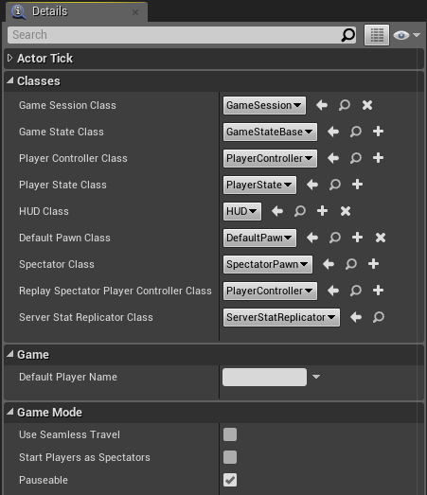
Game Mode
The Game Mode class is used to define the rules of the game. The Game Mode also specifies the default classes that will be used for the creation of Pawn, Player Controller, Game State, HUD, and other classes, as seen in the image on the right.
Each Level can have a different Game Mode. If a Game Mode is not specified for the Level, it will use the Game Mode that has been set for the project.
In a multiplayer game, the Game Mode exists only on the server and is not replicated to the clients.

Slide 5
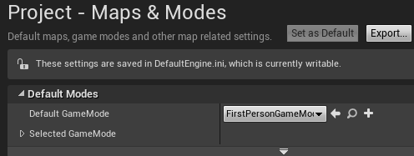
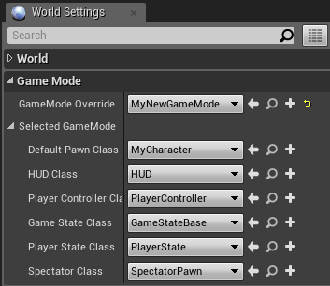
Assigning a Game Mode
To specify the default Game Mode of a project, go to Edit > Project Settings... in the Level Editor and in the Project category select the Maps & Modes option. Choose the Game Mode in the Default GameMode property’s drop-down, as seen in the top image on the right.
To specify the Game Mode of a Level, click the Settings button in the Level Editor and choose the World Settings option. Choose the Game Mode in the GameMode Override property’s drop-down, as seen in the bottom image.
The Game Mode of a Level overrides the default Game Mode of the project.

Slide 6
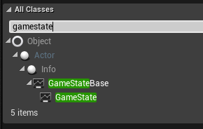
Game state
The Game State class is used to keep track of the variables that represent the current state of the game, and it is shared with all clients in a multiplayer game.
The basic idea is that a Game Mode defines the rules on the server, whereas the Game State manages the information that changes in the game and needs to be sent to the clients.
To use a new Blueprint based on the Game State class, you must assign your custom Game State class to the Game State Class parameter of the Game Mode.
The Game State class extends the Game State Base class and adds some multiplayer functionality.

Slide 7
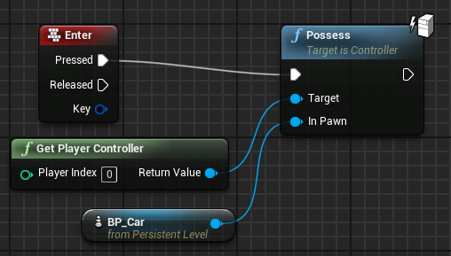
Player Controller
The Controller class has two main subclasses. The Player Controller class is used by human players, and the AI Controller class uses artificial intelligence to control the Pawn.
Pawn and Character classes only receive input events if they are being possessed by a Player Controller.
The Pawn class being possessed by a Player Controller can be changed in-game. The image on the right is from a Level Blueprint and shows the use of the Possess function. In this example, a Player Controller will possess the BP_Car Pawn Actor in the Level when the Enter key is pressed.

Slide 8
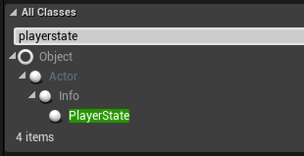
Player state
The Player State class is used to keep track of the information of a specific player that needs to be shared with the others clients in a multiplayer game.
The Player Controller exists only on the clients, while the Player State is replicated to all clients from the server.
To use a new Blueprint based on the Player State class, you must set it in the Player State Class parameter of the Game Mode.

Slide 9
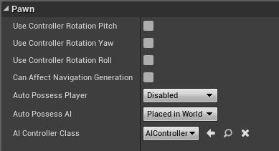
Pawn
Pawns are Actors that can be controlled (possessed) by Controllers (Player or AI).
The Pawn class represents the physical body, and the Controller class represents the brain.
The image on the right shows some of the parameters that are inherited from the Pawn class. The Pawn class can use the rotation values of the Controller that is possessing it.
Other attributes indicate how the Pawn is possessed by a Controller.

Slide 10
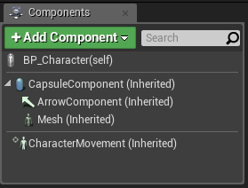
Pawn: Character
The Character class is a subclass of the Pawn class that is made to represent bipedal characters that can walk, run, jump, swim, and fly. This class already has a set of components to assist in this goal.
The image on the right shows the components present in the Character class.
The CapsuleComponent is used for collision testing.
The ArrowComponent indicates the current direction of the character.
The Mesh component is the Skeletal Mesh that visually represents the character. The animation of the Mesh component is controlled by an animation Blueprint.
The CharacterMovement component is used to define various types of character movement such as walking, running, jumping, swimming, and flying.

Slide 11
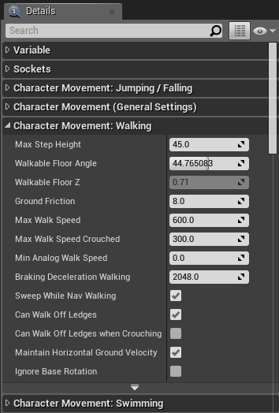
Character movement
The CharacterMovement component is written in C++ and handles movement as well as replication and prediction in multiplayer games.
There are a lot of properties for various types of movements that can be adjusted on the component.

Slide 12
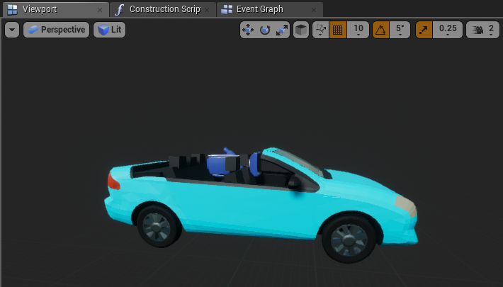
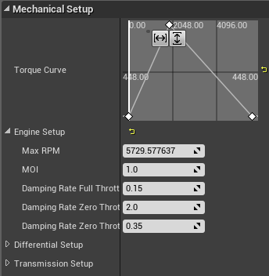
Pawn: Vehicle
The Wheeled Vehicle class is another example of a subclass of the Pawn class.
It contains a VehicleMovement component that is written in C++ and has code to simulate the behavior of a vehicle. It has many parameters used to define the movement and physics of a vehicle. It can also handle replication and prediction in multiplayer games.
The top image on the right is from the Vehicle template.
The image at the bottom shows some properties of a VehicleMovement component.

Slide 13
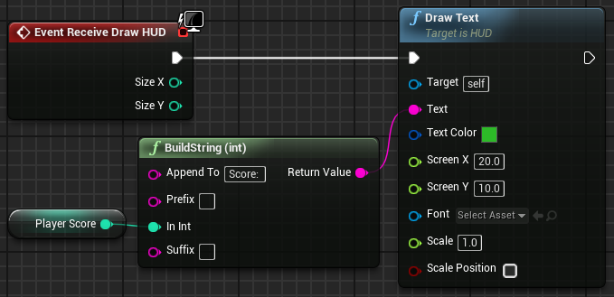
hUd
The HUD class is used to create a heads-up display (HUD), which is a kind of on-screen display that provides quick access to important information. The HUD is used in games to display various information to the players, such as their score, time, energy, and so on.
In Unreal Engine, the HUD class is a base class that contains a Canvas, which is an object on which primitives, such as text and textures, can be drawn.
The HUD class contains an event named “Receive Draw HUD”, which is used to draw the primitives each frame.
The HUD class exists only on each client and does not replicate.

Slide 14
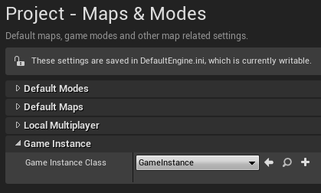
Game instance
An instance of the Game Instance class is created at the beginning of the game and is only removed when the game is closed.
All Actors and other objects in a Level are completely destroyed and respawned each time a Level is loaded.
The Game Instance class and the data it contains persist between Levels.
The Game Instance exists only on each client and does not replicate.
To assign the Game Instance class for use in your game, modify the project’s settings by going to Edit > Project Settings > Maps & Modes.

Slide 15
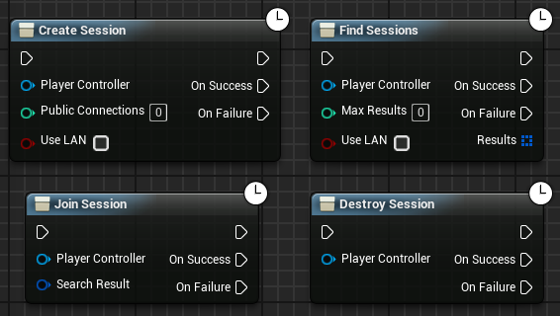
Game session
Simply stated, a Game Session is an interface for a game running on a server that clients can use to discover and join the game.
The image on the right shows some Blueprint functions that can be used to manage a session.

Slide 16
SUMMARY
This lecture presented the Gameplay Framework classes and the relationship between some common classes.
It showed how to possess a Pawn using a Controller and how to draw simple information using the HUD class.

